Slide 1
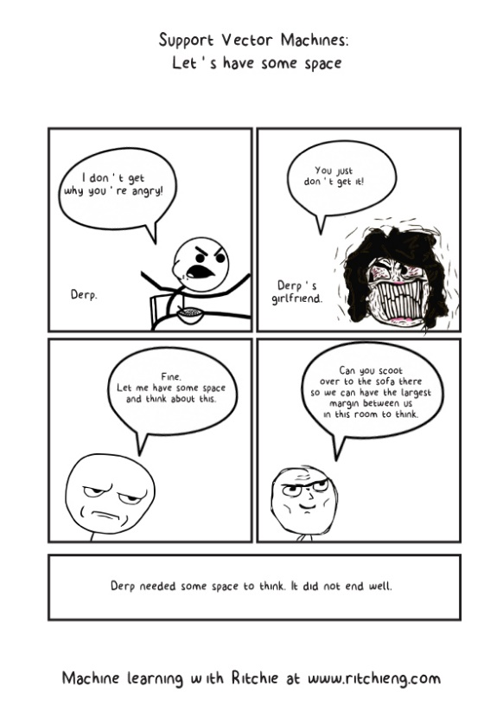
CS 445: Machine Learning
Support Vector Machines

Slide 2
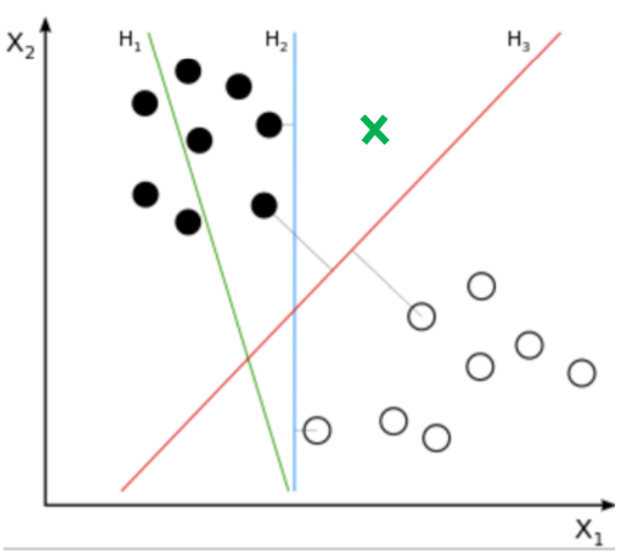
Support Vector Machine - Motivation
To which class would each decision boundary assign the new instance?
Which decision boundary would you choose to separate data?

Slide 3
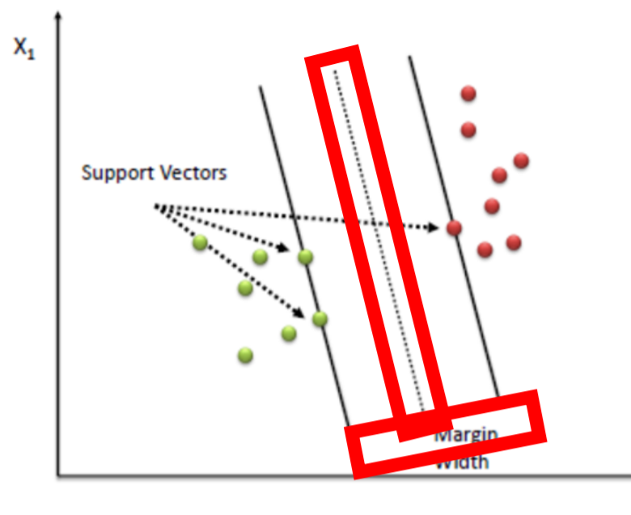
Support Vector Machines - Motivation
Choose hyperplane that maximizes the “margin” width
Margin → distance between the decision boundary (i.e., parallel to hyperplane) and training instances (“support vectors”) closest to the hyperplane
SVM: creates BOTH hyperplane AND margin
Support vectors: controls/defines the margin
Create more generalized model: Low variance
Linearly separable points
Maximum margin classifier
Hyperplane/decision
boundary

Slide 4
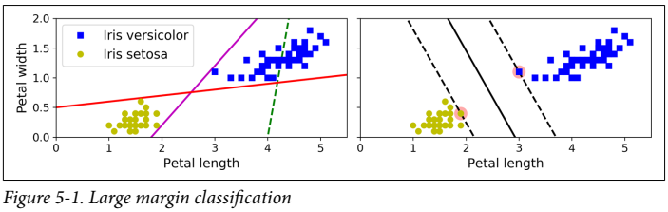
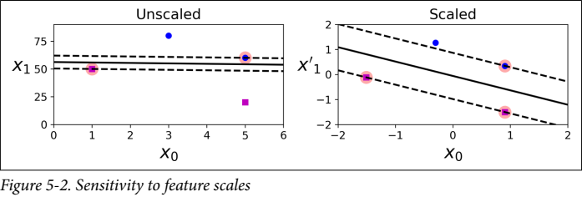
Support Vector Machine
Linear or nonlinear classification, regression, outlier detection
Excellent for small or medium sized datasets
Large margin classification - fit the widest possible street between the classes
More instances “off-the-street” does not affect decision boundary

Slide 5
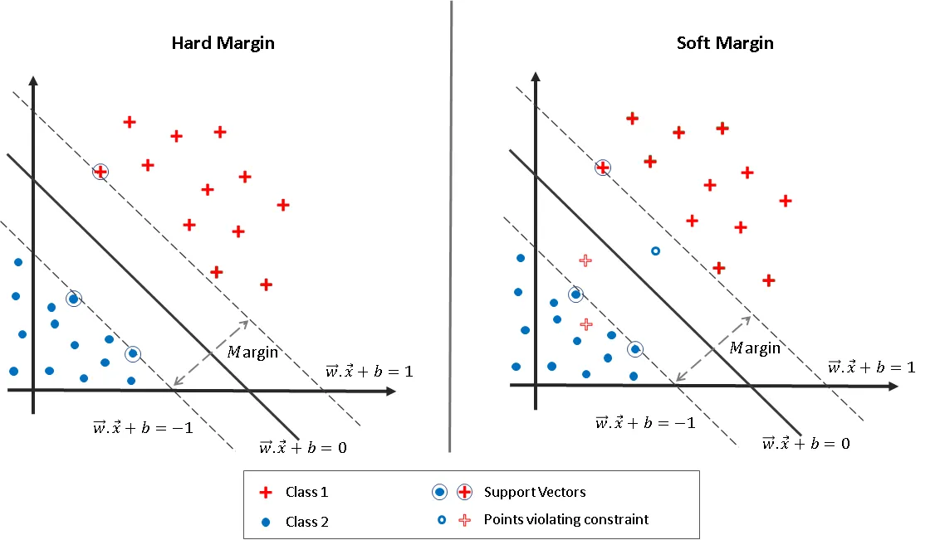
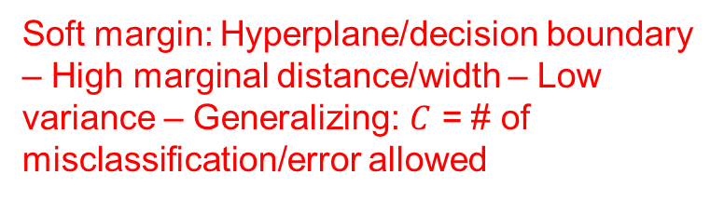
Hard Margin vs Soft Margin SVM
When the data is linearly separable, and we don’t want to have any misclassifications, we use SVM with a hard margin.
However, when a linear boundary is not feasible, or we want to allow some misclassifications in the hope of achieving better generality, we can opt for a soft margin for our classifier.
Hard margin: No data points are allowed in the margin areas
Hard margin: Hyperplane/decision boundary – Low marginal distance/width – High variance – Not generalizing
Low bias – No training error
No misclassification/error is allowed
Soft margin: Hyperplane/decision boundary – High marginal distance/width – Low variance – Generalizing: $C$ = # of misclassification/error allowed

Slide 6
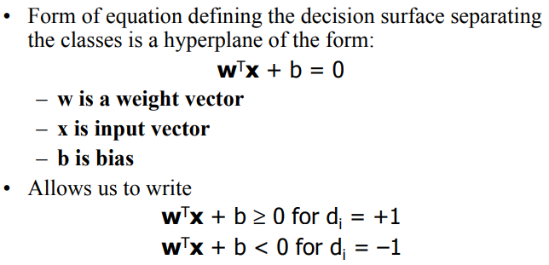
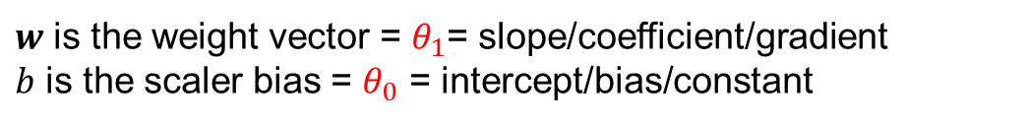
Hard Margin Classifier Objective
SVM Optimization problem:
Equation of a line: standard/matrix form
$w$ is the weight vector = $θ_{1}$= slope/coefficient/gradient
$b$ is the scaler bias = $θ_{0}$ = intercept/bias/constant

Slide 7
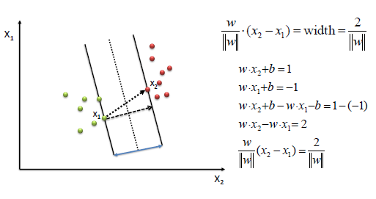
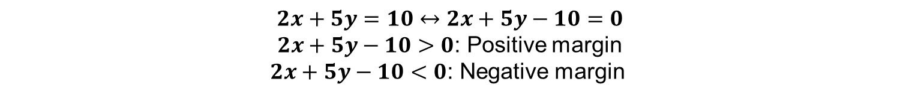
Hard Margin Classifier Objective
SVM Optimization problem:
Goal: maximize
$$2x+5y=10↔2x+5y−10=0$$
$2x+5y−10>0$: Positive margin
$2x+5y−10<0$: Negative margin

Slide 8
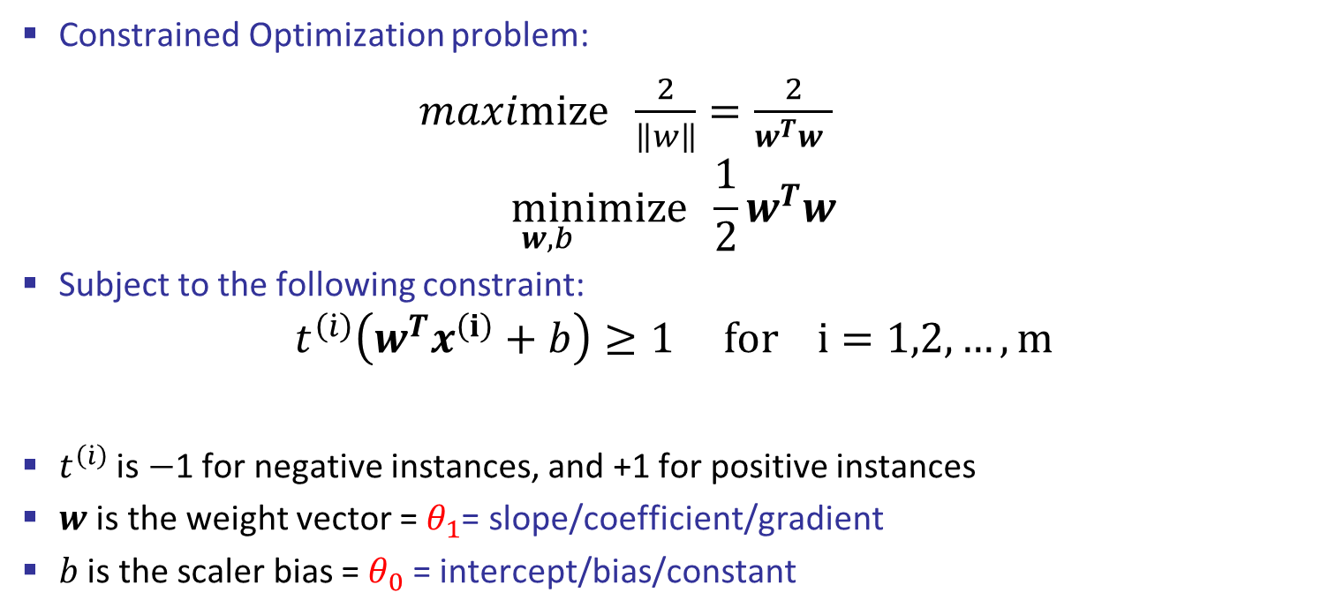
Hard Margin Classifier Objective
Constrained Optimization problem:
$maximize \frac{2}{\left\|w\right\|}=\frac{2}{w^{T}w }$
$$\min_{w,b}ⅈmize \frac{1}{2}w^{T}w$$
Subject to the following constraint:
$$t^{\left(\dot{i}\right)}\left(w^{T}x^{\left(ⅈ\right)}+b\right)≥1 for i=1,2,…,m$$
$t^{\left(\dot{i}\right)}$ is $−$1 for negative instances, and +1 for positive instances
$w$ is the weight vector = $θ_{1}$= slope/coefficient/gradient
$b$ is the scaler bias = $θ_{0}$ = intercept/bias/constant

Slide 9
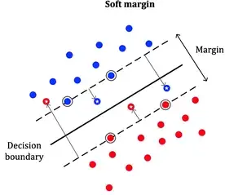
Soft Margin Classification
Can’t strictly enforce all training data to be on the correct side of the decision boundary (hard margin classification) – only works if it’s linearly separable
Adversely affected by outliers
Keep margin as wide as possible, while limiting margin violations
C → hyperparameter controlling number of margin violations/ allowed misclassification/error
Penalty for allowed misclassification/error
Penalty depends on the distance of the misclassification
point from its correct margin = slack variable (ζ) zeta

Slide 10
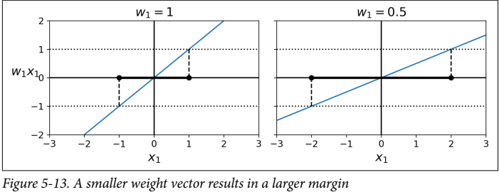

Training Objective
Slope of the decision function is equal to the norm of the weight vector $\left\|w\right\|$
Smaller weight vector $w$ means larger margin
Minimize $\left\|w\right\|$ to get a large margin, while avoiding margin violations

Slide 11
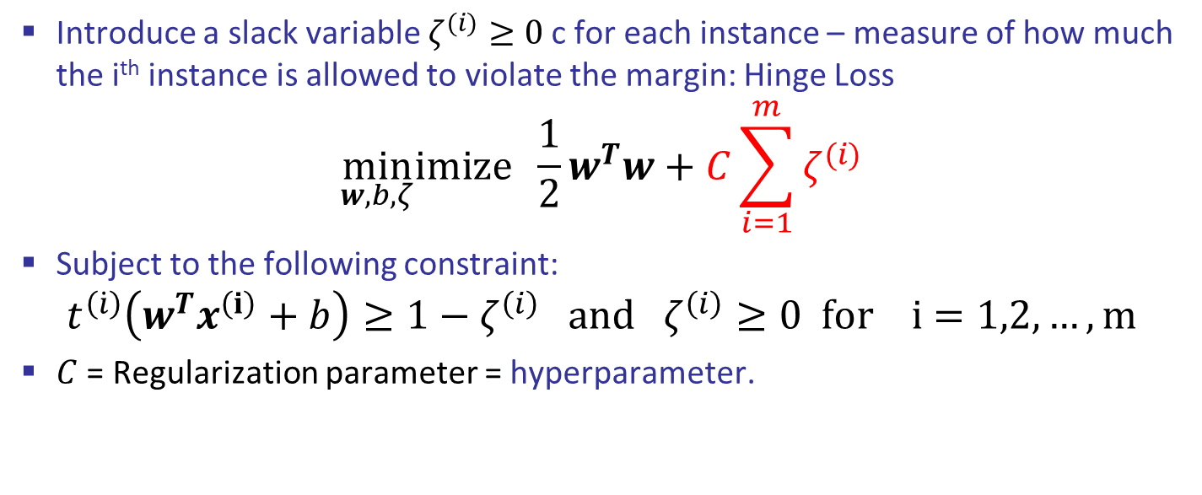
Soft Margin Classifier Objective
Introduce a slack variable $ζ^{(i)}≥0$ c for each instance – measure of how much the i^{th} instance is allowed to violate the margin: Hinge Loss
$$\min_{w,b,ζ}ⅈmize \frac{1}{2}w^{T}w+C\sum_{i=1}^{m}{ζ^{(i)}}$$
Subject to the following constraint:
$$t^{\left(\dot{i}\right)}\left(w^{T}x^{\left(ⅈ\right)}+b\right)≥1−ζ^{\left(i\right)} and ζ^{\left(i\right)}≥0 for i=1,2,…,m$$
$C$ = Regularization parameter = hyperparameter.

Slide 12
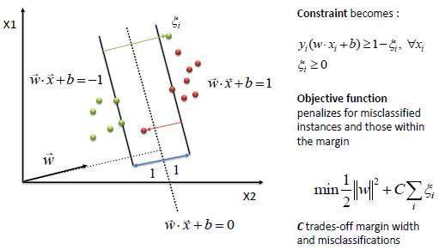
Soft Margin Classifier Objective

Slide 13
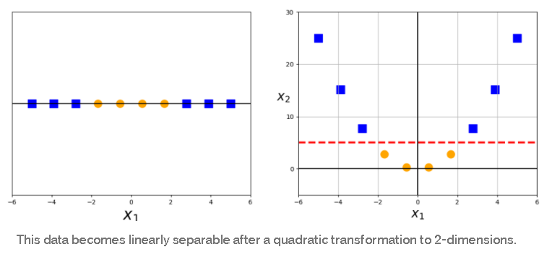
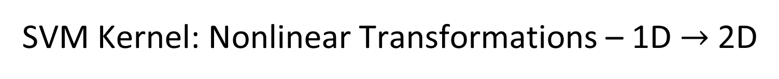
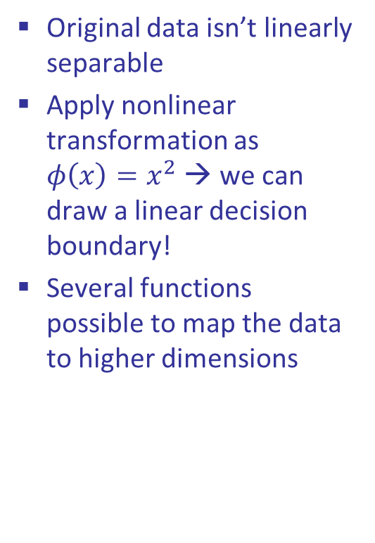
SVM Kernel: Nonlinear Transformations – 1D $→$ 2D
If data isn’t linearly separable in the original space → map it to a higher dimensional feature space: Kernel trick: convert low dimension to higher dimension
Original data isn’t linearly separable
Apply nonlinear transformation as $φ\left(x\right)=x^{2}$ → we can draw a linear decision boundary!
Several functions possible to map the data to higher dimensions

Slide 14
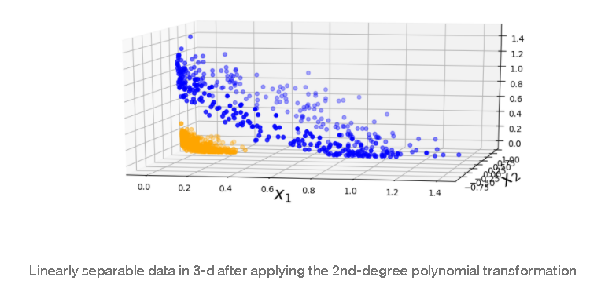
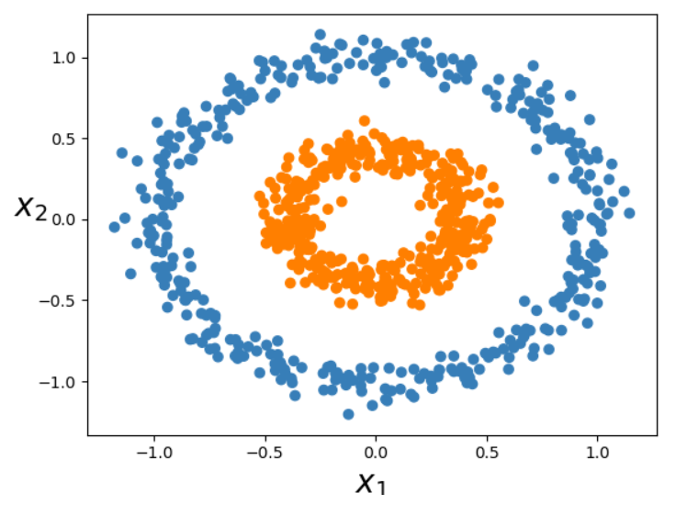
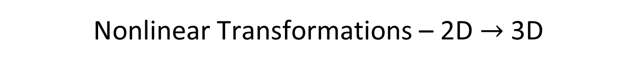

Nonlinear Transformations – 2D $→$ 3D
Applying a second-degree polynomial mapping →
$$φ\left(x\right)=φ\left(\left(\begin{matrix}x_{1} \\ x_{2}\end{matrix}\right)\right)=\left(\begin{matrix}x_{1}^{2} \\ x_{1}x_{2} \\ x_{2}^{2}\end{matrix}\right)$$
Note: Transformed vector is 3D!

Slide 15
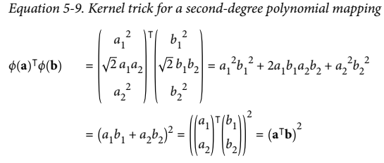
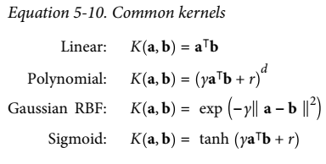
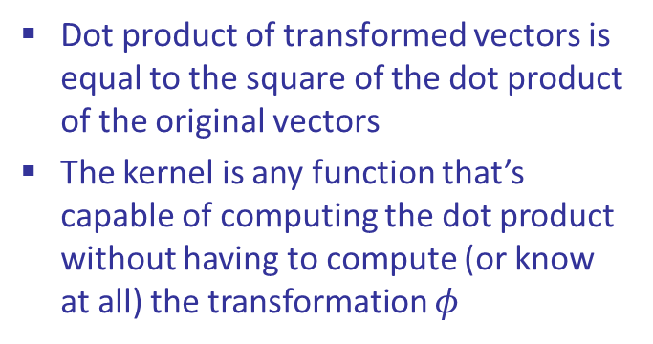
Kernel Trick
Kernel function → takes vectors in the original lower dimensional space as inputs, and returns the dot product of the transformed vectors in the higher dimensional feature space
Consider a couple of 2D vectors a, b
Dot product of transformed vectors is equal to the square of the dot product of the original vectors
The kernel is any function that’s capable of computing the dot product without having to compute (or know at all) the transformation $φ$

Slide 16
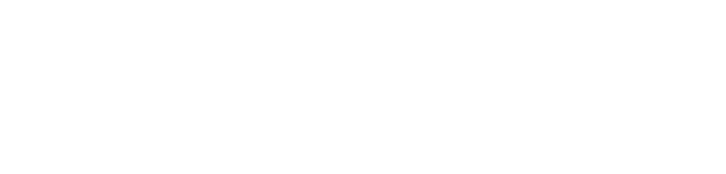
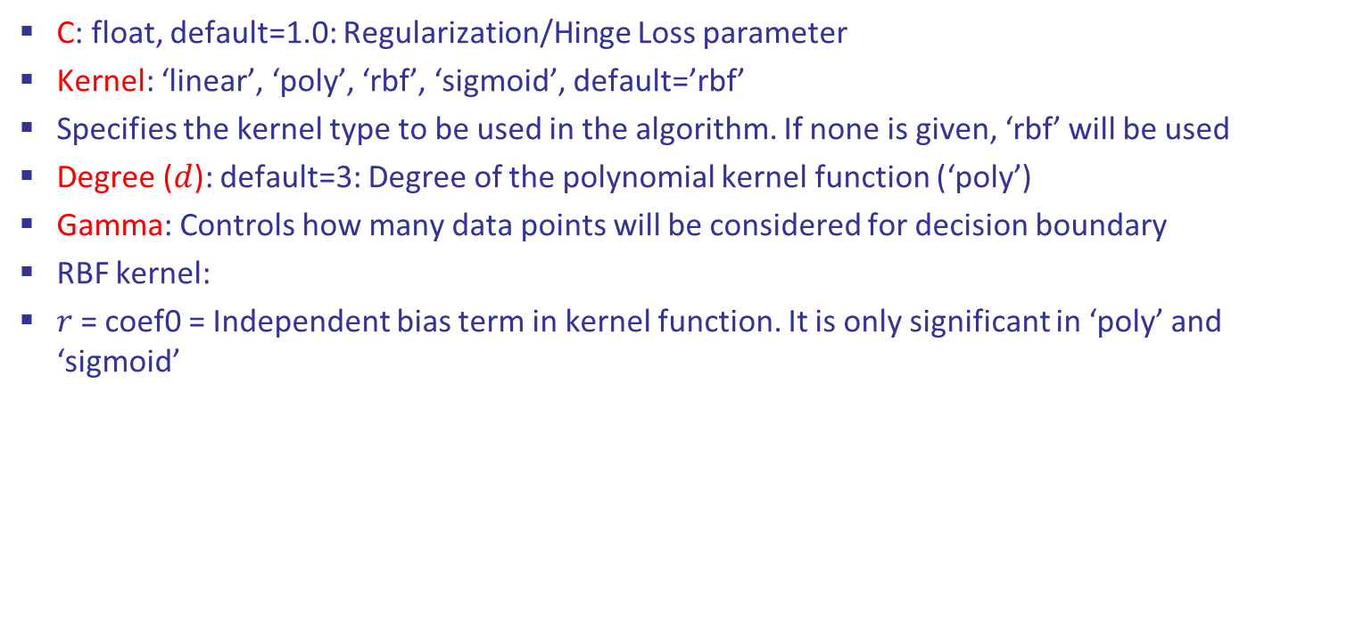
SVM Hyperparameters
C: float, default=1.0: Regularization/Hinge Loss parameter
Kernel: ‘linear’, ‘poly’, ‘rbf’, ‘sigmoid’, default=’rbf’
Specifies the kernel type to be used in the algorithm. If none is given, ‘rbf’ will be used
Degree ($d$): default=3: Degree of the polynomial kernel function (‘poly’)
Gamma: Controls how many data points will be considered for decision boundary
RBF kernel:
$r$= coef0 = Independent bias term in kernel function. It is only significant in ‘poly’ and ‘sigmoid’

Slide 17
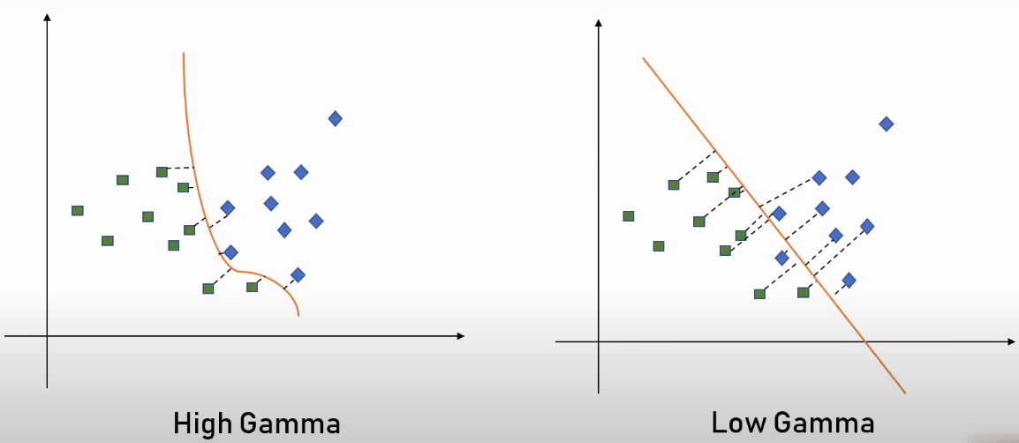
SVM Gamma
Gamma: Controls how many data points will be considered for decision boundary
High gamma: Only the closest points (less points) will be used to draw the decision boundary
Low gamma: Far away points (more points) will be used to draw the decision boundary

Slide 18
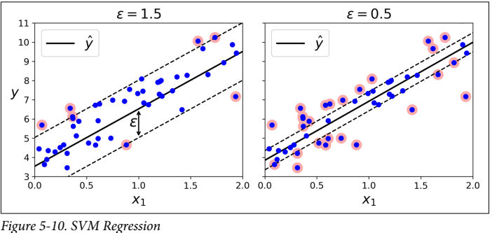
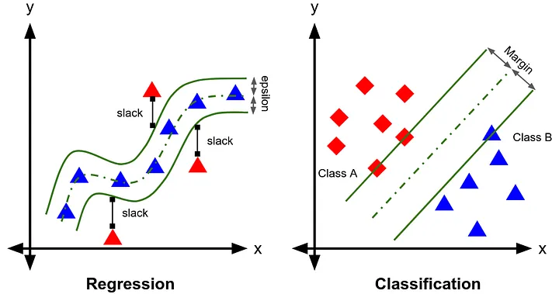
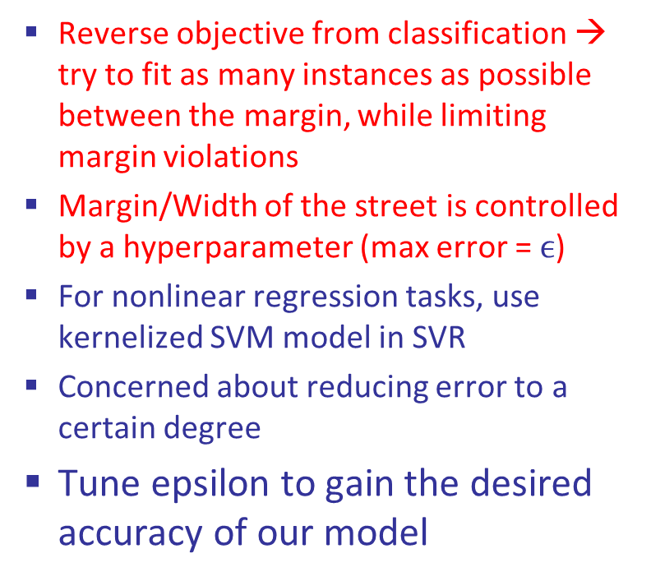
Support Vector Regression
Reverse objective from classification → try to fit as many instances as possible between the margin, while limiting margin violations
Margin/Width of the street is controlled by a hyperparameter (max error = $ϵ$)
For nonlinear regression tasks, use kernelized SVM model in SVR
Concerned about reducing error to a certain degree
Tune epsilon to gain the desired accuracy of our model

Slide 19
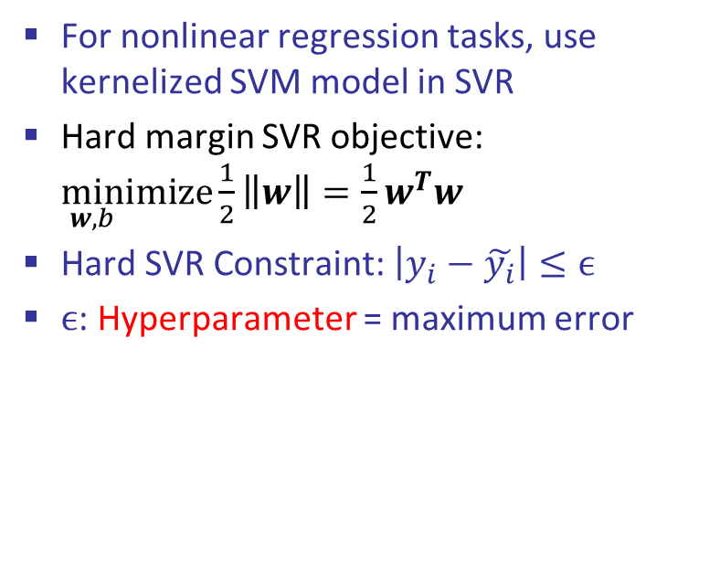
Support Vector Regression
For nonlinear regression tasks, use kernelized SVM model in SVR
Hard margin SVR objective: $\min_{w,b}ⅈmize\frac{1}{2}\left\|w\right\|=\frac{1}{2}w^{T}w$
Hard SVR Constraint: $\left|y_{i}−\tilde{y_{i}}\right|≤ϵ$
$ϵ$: Hyperparameter = maximum error

Slide 20
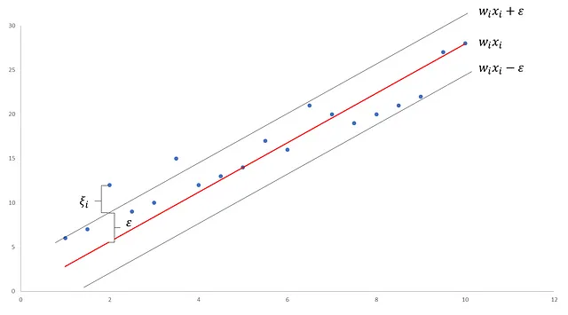

Support Vector Regression
Soft margin SVR objective: $\min_{w,b,ζ}ⅈmize \frac{1}{2}w^{T}w+C\sum_{i=1}^{m}{ζ^{(i)}}$
Soft SVR Constraint:
$\left|y_{i}−\tilde{y_{i}}\right|<ϵ+C\sum_{i=1}^{m}{ζ^{(i)}}$

Slide 21
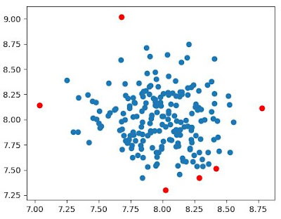

SVM For Outlier/ Anomaly Detection
One-Class SVM: unsupervised model for anomaly or outlier detection.
Unlike the regular supervised SVM, the one-class SVM does not have target labels for the model training process.
Learns the boundary for the normal data points and identifies the data outside the border to be anomalies
Hyperparameter $nu$ is to specify the percentage of anomalies. $nu$=0.01 means that we have around 1% outliers in the dataset
# of outlier = 6

